Slide 1

DEVIANCE &
SOCIAL CONTROL

Slide 2
Questions for today
How do we understand deviance as a form of social control?
How do individual and structural theories of deviance differ?
How is crime a form of deviance? Why do people commit crime?
What is the state of violence in society?

Slide 3
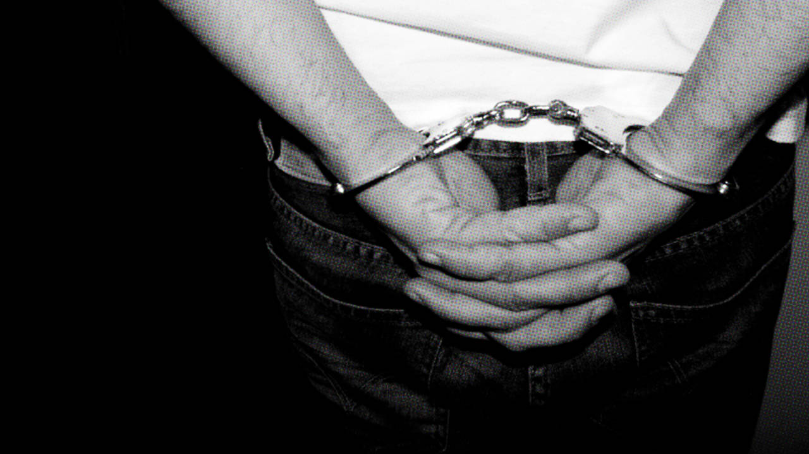
INTERPRETING DEVIANCE

Slide 4
Rank the Following from Least to Most Deviant
Speeding in a School Zone
Catching a fish with your bare hands
Loudly playing the trumpet on the subway and demanding money
Cheating on your wife who has Stage 4 cancer
Being part of a religion that does not believe in using any medical interventions
Applying the above religion to medical choices for your children under 18
Going naked in public
Jaywalking
Giving whiskey to dogs
Giving whiskey to children
Chasing down and shooting a stranger who is walking in your neighborhood
Knowingly polluting a water supply for local families with harmful chemicals and not informing them

Slide 5
Thinking about deviance and social control
Is it any behavior that’s weird or unusual?
Only illegal acts? Acts against the rules?
Only non-normative behaviors?
Yes. But it depends.
Deviance includes behaviors that violate social norms

Slide 6
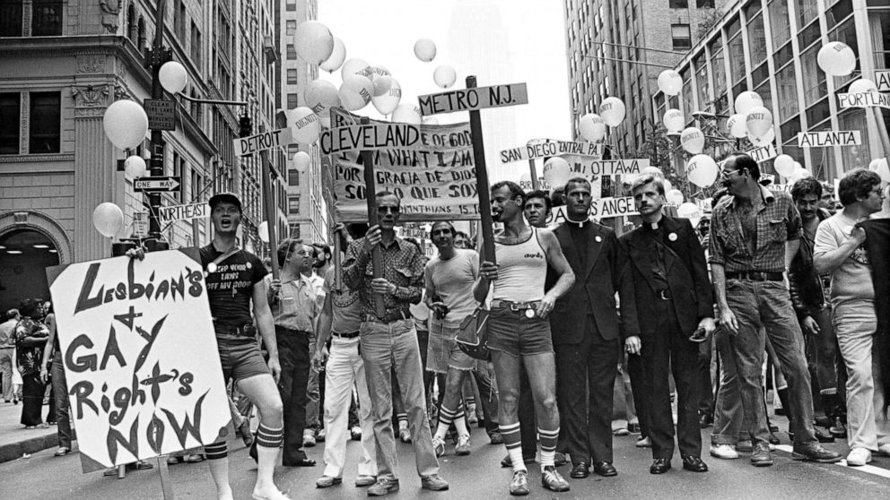
Deviance
Definition: Behaviors that violate social norms
However, requires we make assumptions of social reality

Slide 7
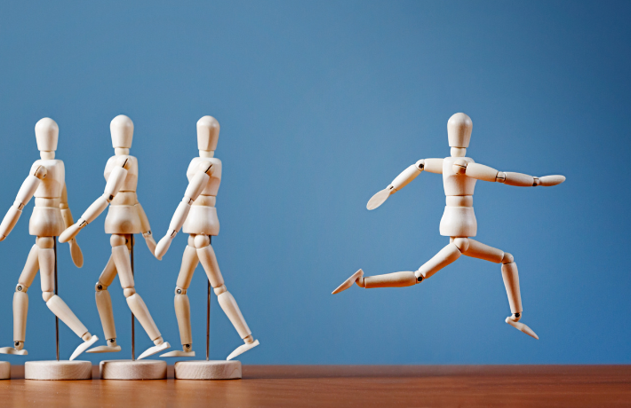
Norms
Folkways
  Least serious: Customs
Mores
  More serious: Values and morals
Laws
  Codified

Slide 8
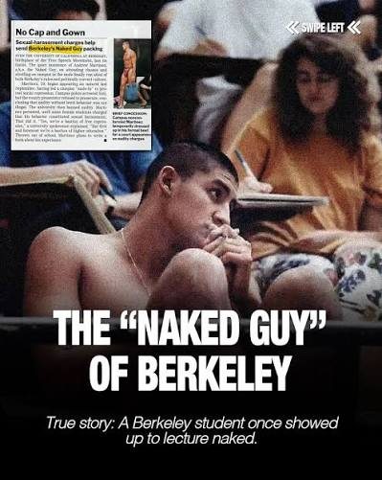
Case study: Andrew Martinez
Nude rights activist who began refusing to wear clothes around UC Berkeley.
No local laws or institutional rules opposing nudity.
Law passed to criminalize nudity and subsequent arrest

Slide 9
Reading Questions
What were the primary factors that contributed to the breakdown of inmate control and management at the penitentiary leading up to the riot?
How did the social structure of the prison impact various forms of deviance inside the prison?
Why do you think some prisoners participated in violence while others did not?

Slide 10
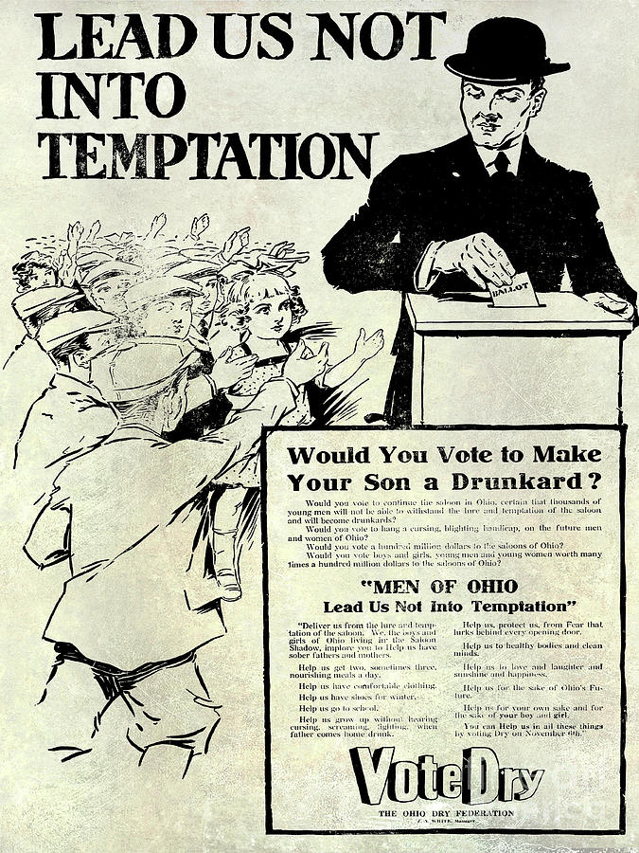
Deviance is social
Moral Entrepreneur: Individuals or groups that seek to change norms to align to their own worldview (often through activism).

Slide 11
Moral Panics
Successful moral entrepreneurship can sometimes lead to…
Moral Panic: an exaggerated, widespread fear regarding the collapse of public morality
Examples:
  Sexting
  Immigration
  College politics
  Transgender Athletes

Slide 12

AshleyMadison.com Hack
In July 2015, hacker group released user data including personally identifiable information from website for married people seeking extramarital affairs.
Outcomes included public shaming, extortion, legal consequences, and suicides.
Multiple forms of deviance:
Theft and release of personal information
Marital infidelity (intended or actual)
Suicides
Questions
Which was most deviant and why?
Do you reject the label deviant for any of these behaviors? Why or why not?
Who was likely punished the most severely? Web site operators, users, or hackers? Does severity of punishment match the deviance?

Slide 13
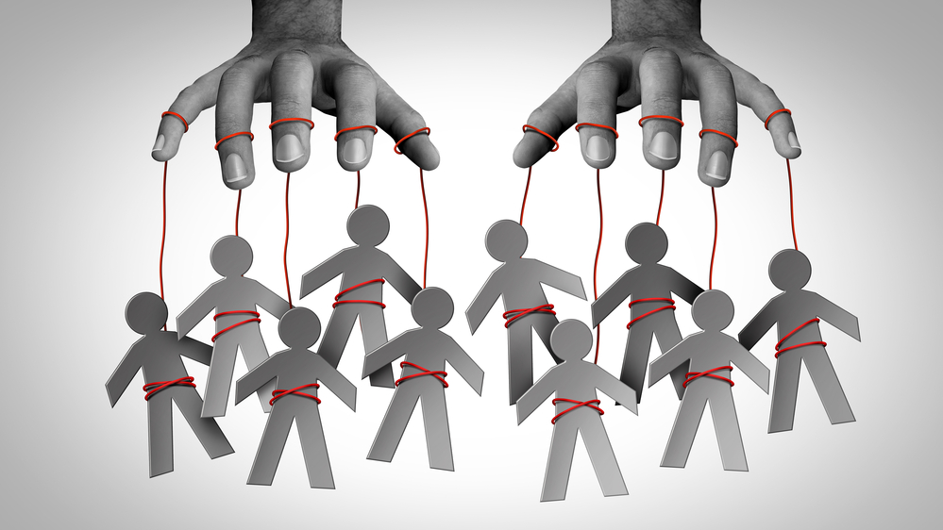
THEORIES OF DEVIANCE AND SOCIAL CONTROL

Slide 14
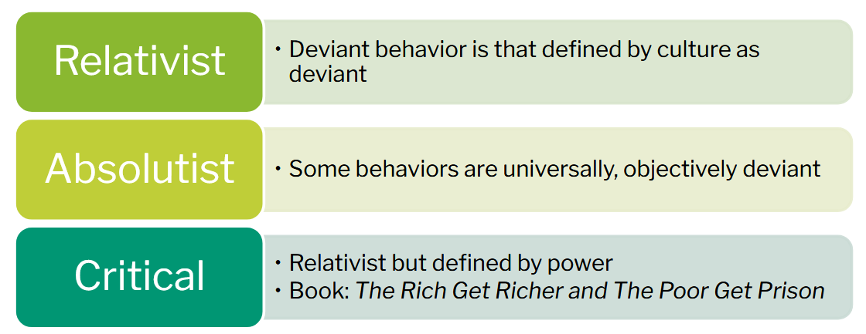
Deviance Perspectives

Slide 15
Deviance builds social cohesion
Durkheimian view: Deviance serves a social function.
Tells us right from wrong
Establishes boundaries
Punishment is for us, not them
The normality of crime

Slide 16
Deviance also results from lack of cohesion
Durkheim’s classic study of suicide in France
Suicide is viewed as individual, but rates vary by country, race, and gender.
Theory: Rapid social changes and lack of social cohesion or regulation: led people to feel left out

Slide 17
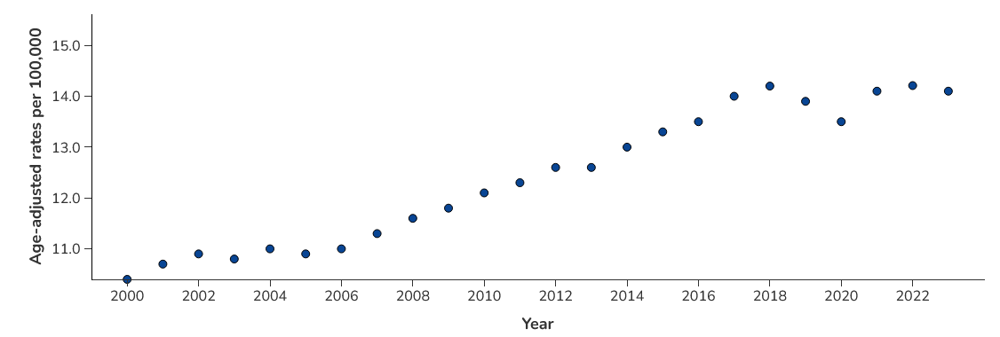
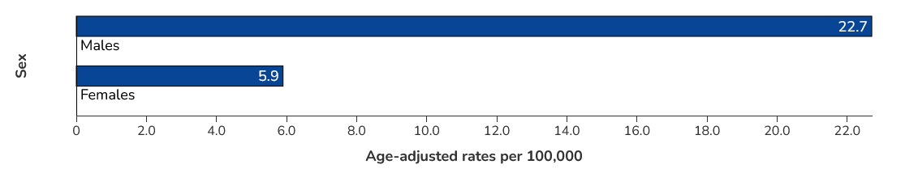

Slide 18
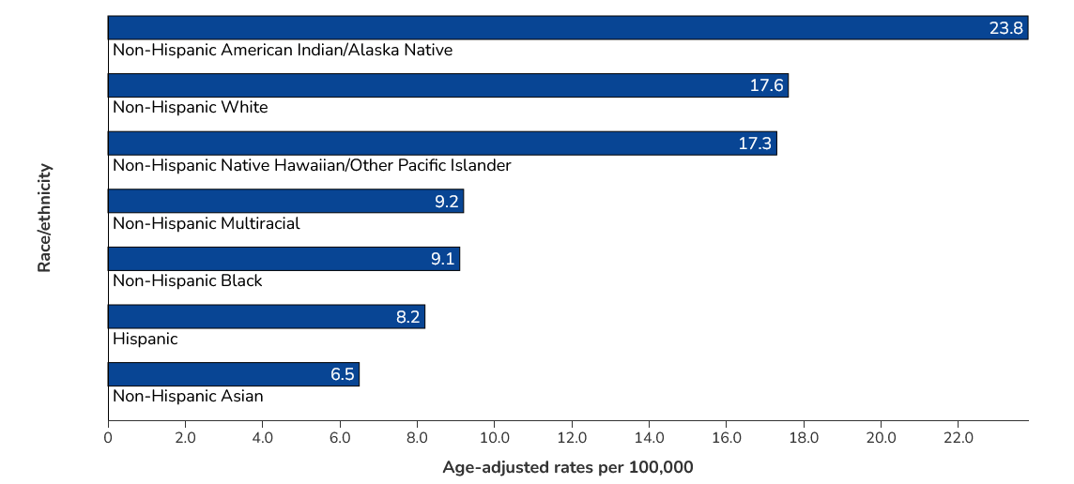

Slide 19
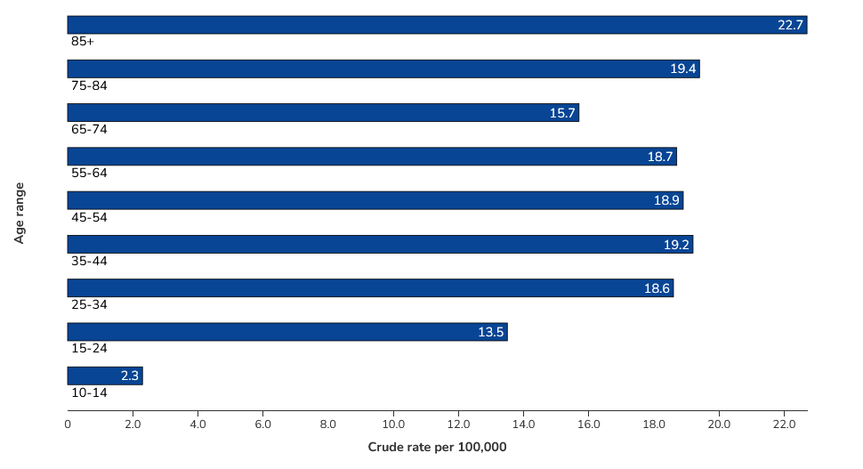

Slide 20
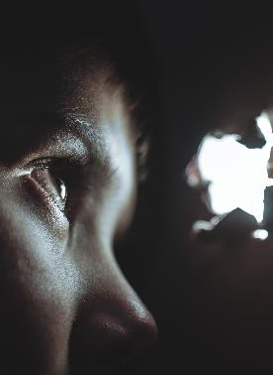
Anomie
Lack of social norms to guide behavior
Deviance occurs when there is a mismatch between a person’s goals and whether they have the means to achieve them

